Slide 1
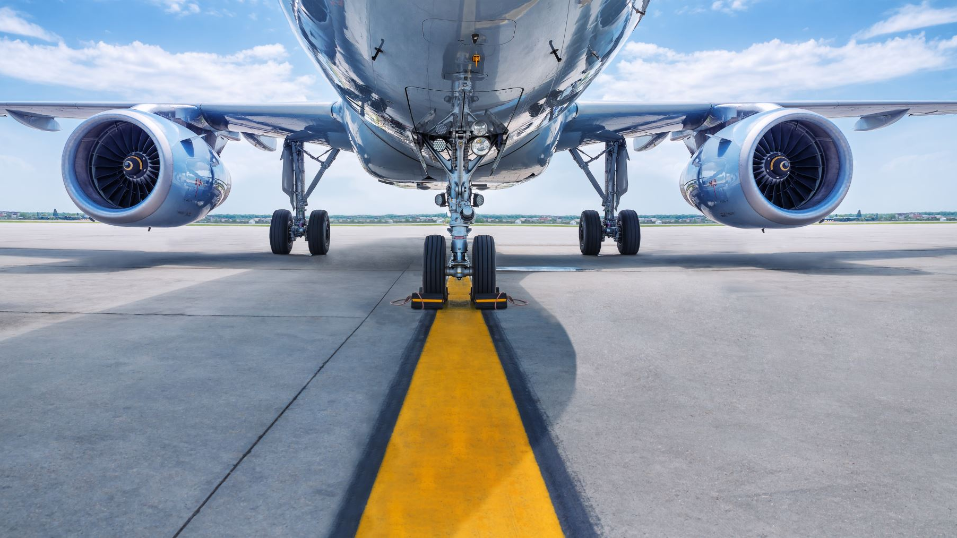
Aviation Safety & Statistics
Airline Industry Facts
Airline Accidents & Fatalities
Airplane VS. Other Transportation Methods
Impact of COVID-19
What Does Research & Science Say?/ Recommendations
Data Presentation & Visualization
Enkhchimeg Tsendnyam

Slide 2
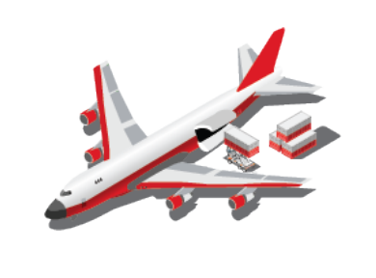




AIRLINE INDUSTRY WORLDWIDE 2019 FACTS
About $7 trillion worth of goods shipped by air cargo each year
Over 11 million
direct employees
About 500,000 people are up in the air at any given time
Roughly 100,000 flights per day across the globe
Highest-risk accident categories:
• Runway safety related events
• Loss of Control In-Flight
• Controlled flight into terrain
Over 5,000 airlines with ICAO codes
Sources: International Civil Aviation Organization (ICAO)

Slide 3
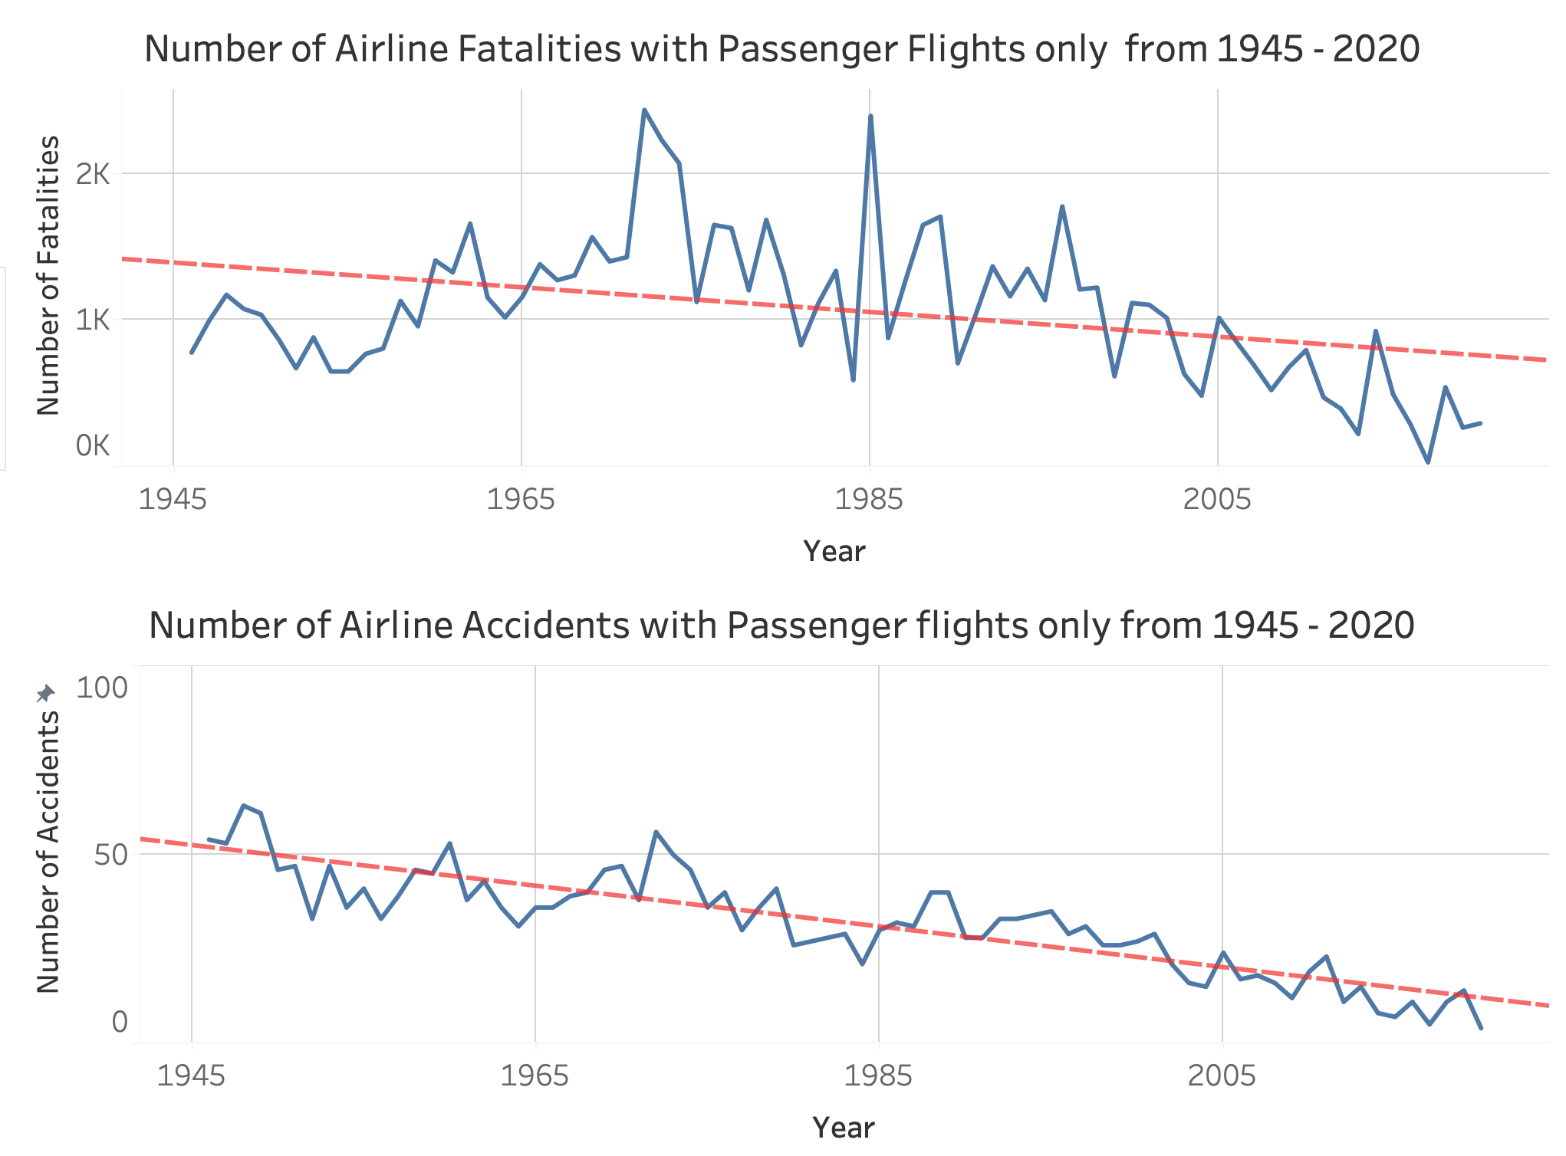
AIRLINE ACCIDENTS & FATALITIES’ WORLDWIDE

Slide 4
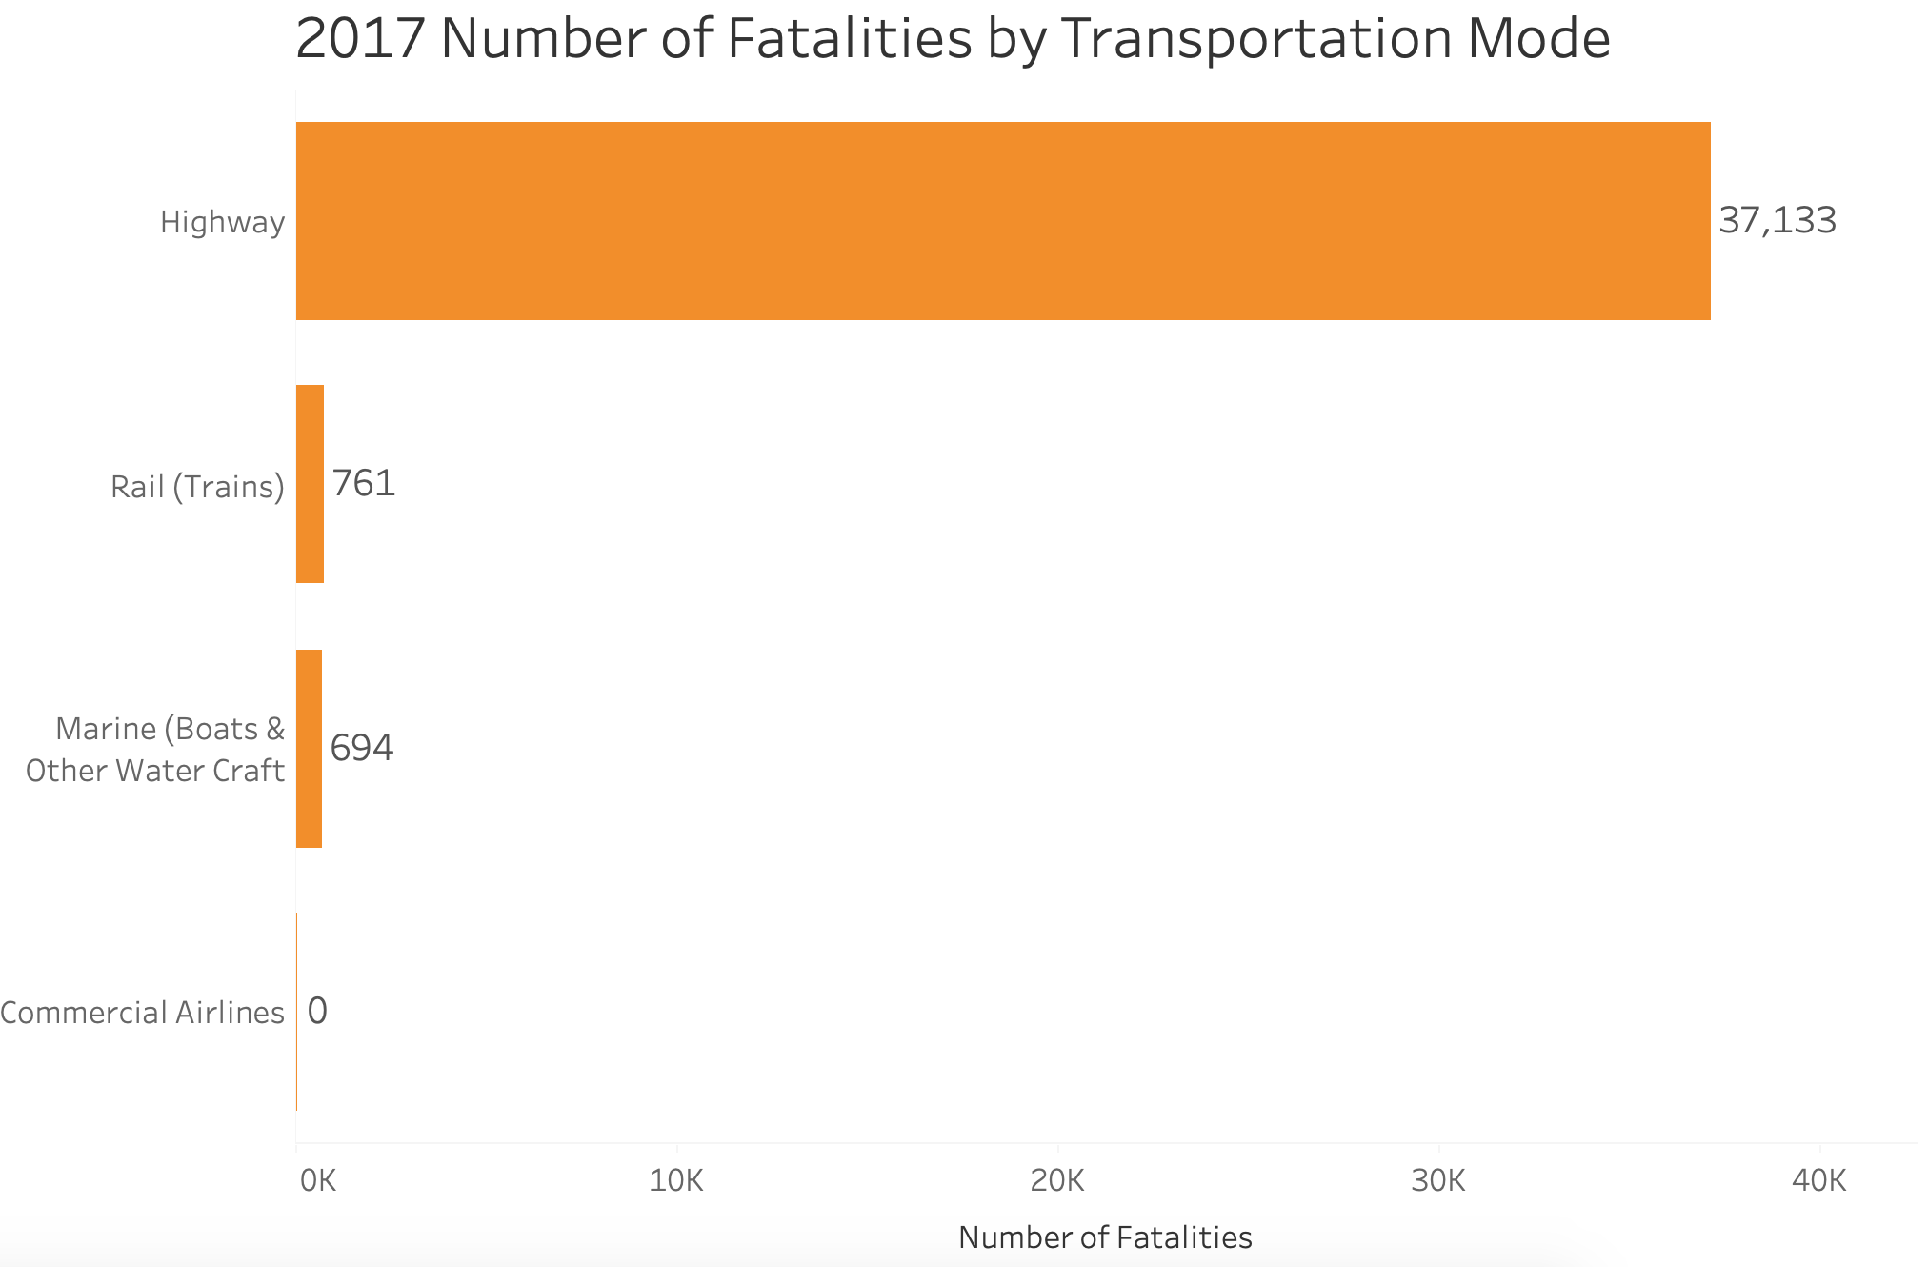
AIRPLANE VS. OTHER TRANSPORTATION METHODS
Between 2012-2016, there was a 1 in 3.37 billion chance of dying in a commercial plane crash. During the same period, there was a 1 in 320 million chance of being on a commercial airline flight experiencing a fatal accident
Flying is the safest transportation method!

Slide 5
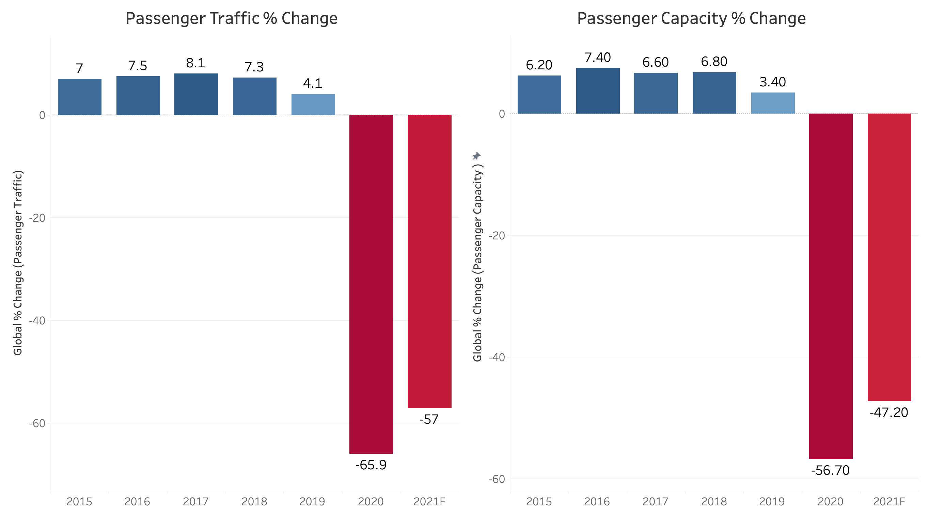
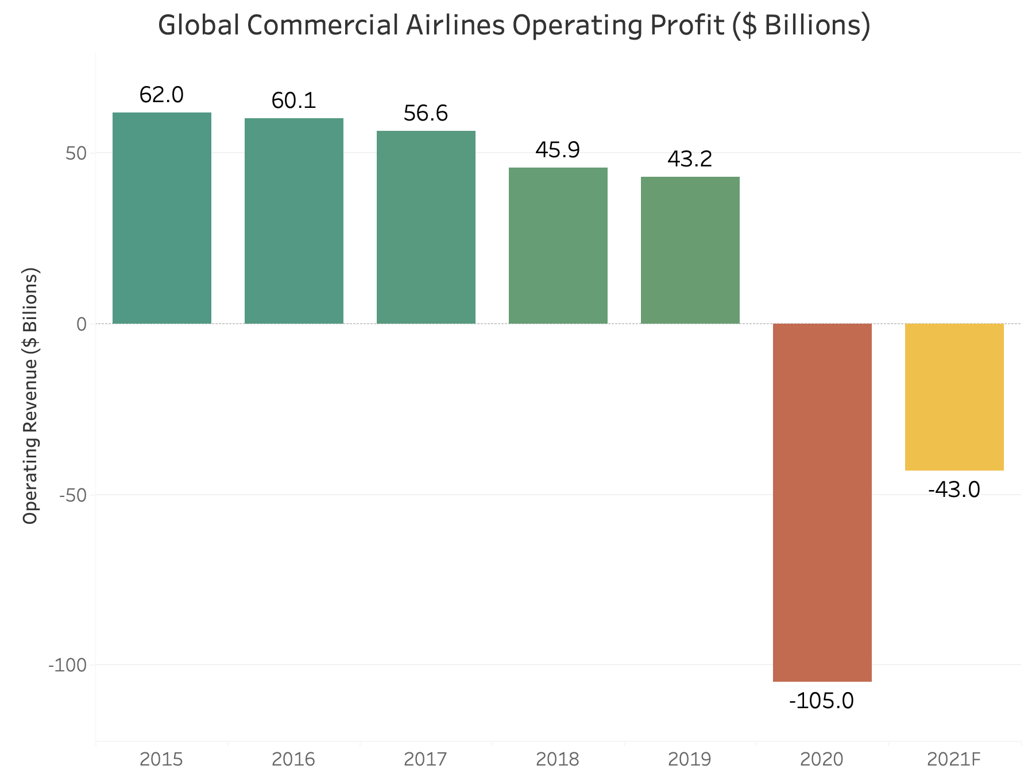
IMPACT OF COVID-19 ON AIRLINE INDUSTRY
Sources: International Air Travel Association (ITAO)

Slide 6





WHAT DOES RESEARCH & SCIENCE SAY?
First comprehensive research from the Harvard University School of Public Health found that having multiple layers of protection against COVID-19 such as getting vaccinated, social distancing and wearing masks make being on an airplane as safe as if, not substantially safer, than other routine activities like grocery shopping or frequenting a local restaurant.
Want to Travel Safely?
Get Vaccinated
Wear a Mask
Social Distance
Wash Your Hands

Slide 7
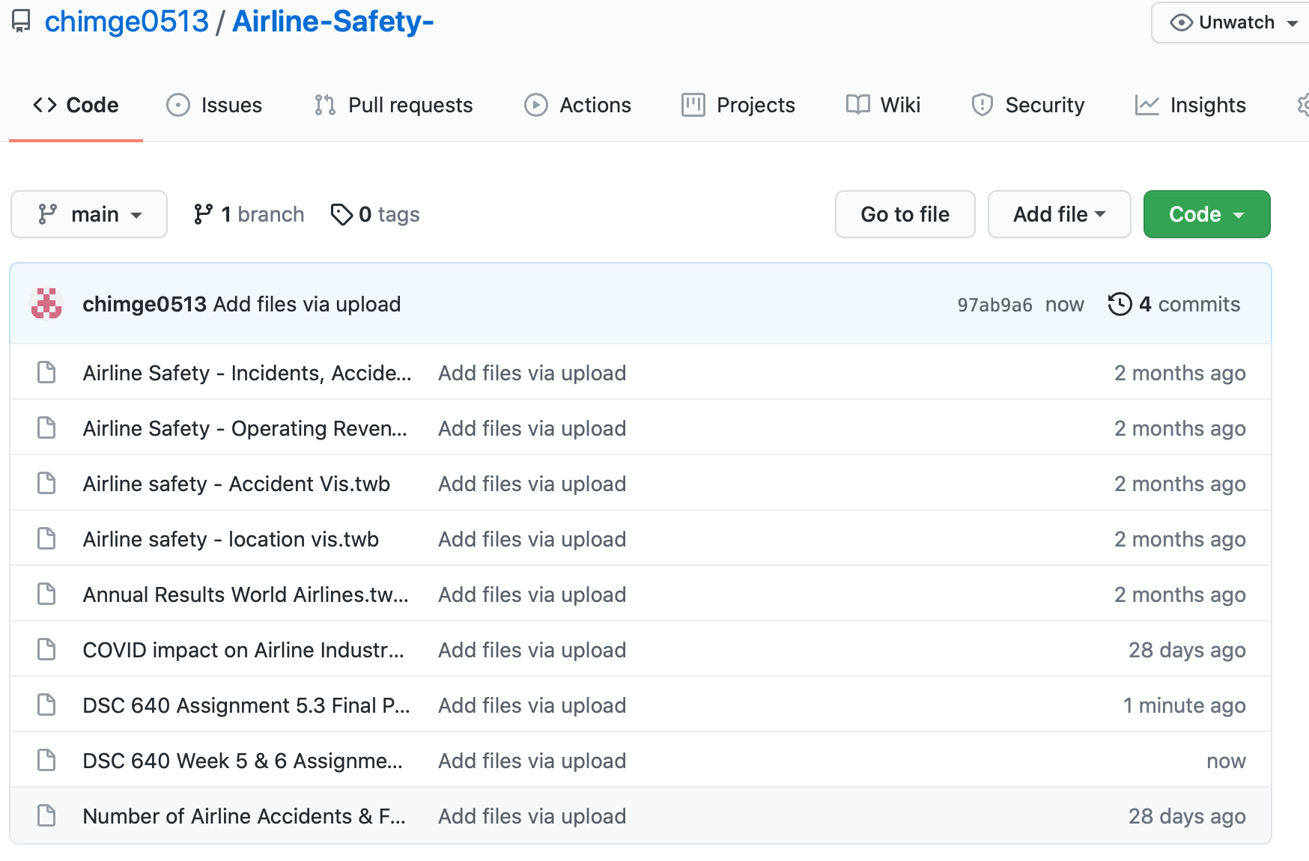
GitHub Repository Linked

Slide 8
References:
International Air Transport Association. (2021, April). Industry Statistics Fact Sheet April 2021. www.iata.org.
Ranter, H. (n.d.). Aviation Safety Network > ASN Aviation Safety Database > Aircraft type index. Aviation Safety Network > https://aviation-safety.net/database/type/index.php.
https://www.airlines.org/dataset/world-airlines-traffic-and-capacity-2/
Deane, S. (2021, May 11). Fear of Flying Statistics (2021 Data). Stratos Jet Charters, Inc. https://www.stratosjets.com/blog/fear-of-flying-statistics-trends-facts/.
https://www.washingtonpost.com/opinions/2021/03/15/flying-safer-than-driving-pandemic/
Statistics. Bureau of Aircraft Accidents Archives. (n.d.). http://www.baaa-acro.com/statistics.
A4A Presentation: Industry Review and Outlook. Airlines For America. (n.d.). https://www.airlines.org/dataset/a4a-presentation-industry-review-and-outlook/.
Parker-pope, T. (2021, August 3). Should I Mask? Can I Travel? What about HUGS? How delta is changing advice for the vaccinated. The New York Times. https://www.nytimes.com/2021/08/03/well/live/covid-delta-variant-vaccine-symptoms.html.

